Slide 1
Typescript for productivity
Why you should use it in every project with multiple developers

Slide 2
Introduction
The purpose of this talk is to introduce TypeScript and convince those who are not using it to give it a try in their next project, especially if it’s a medium to large project with multiple developers.

Slide 3
Introduction to TypeScript
TypeScript is a superset of JavaScript that adds (optional) type annotations and, thus, static typing on top of JavaScript.
TypeScript is open-source and maintained by Microsoft.
Microsoft introduces TypeScript as “JavaScript that scales”.
Most of the JS code we write on the front-end is transpiled anyways, so why not add static type checking to the step?

Slide 4
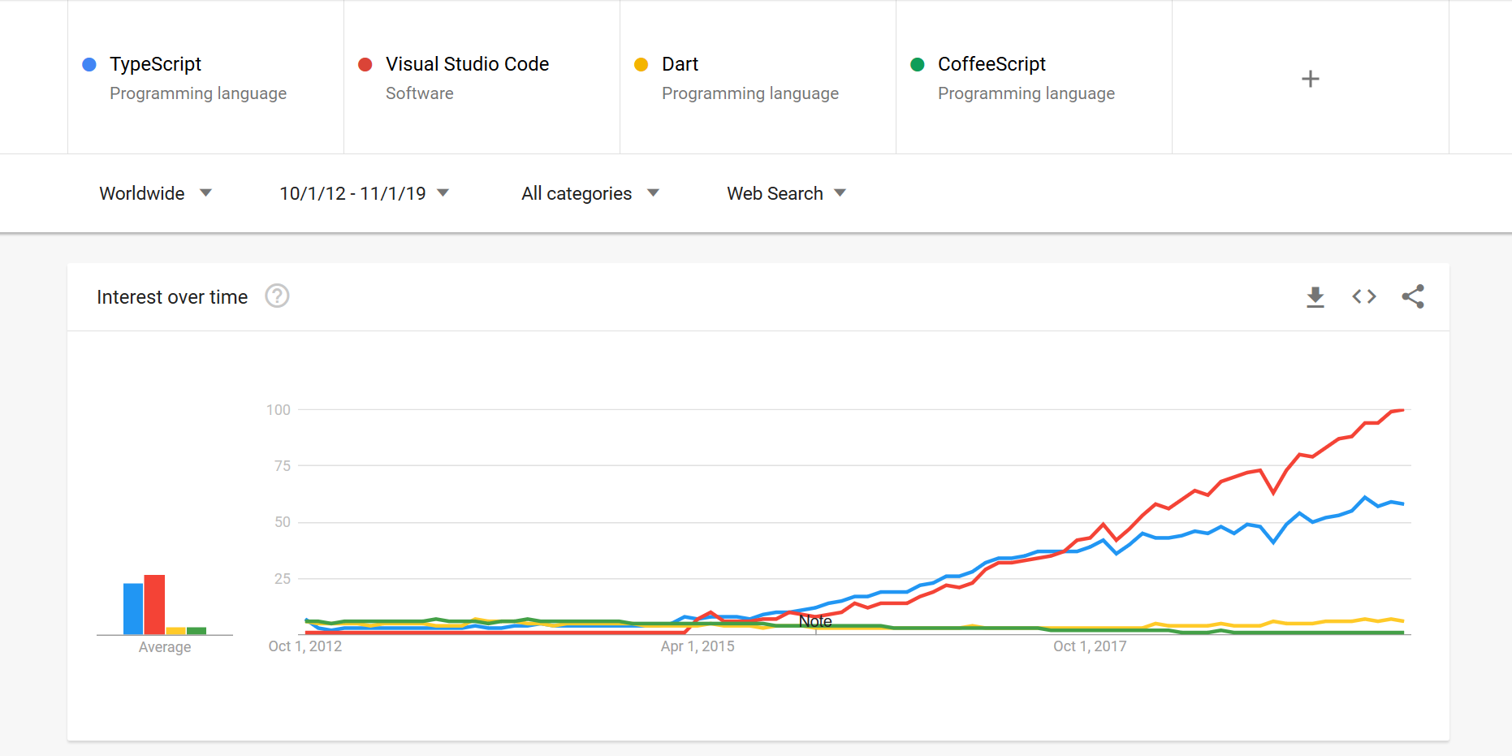
Notes:
TS first appeared on October 1, 2012
Visual Studio Code was released on April 29, 2015
Angular 2 (which adopted TS) was released in September 2016

Slide 5
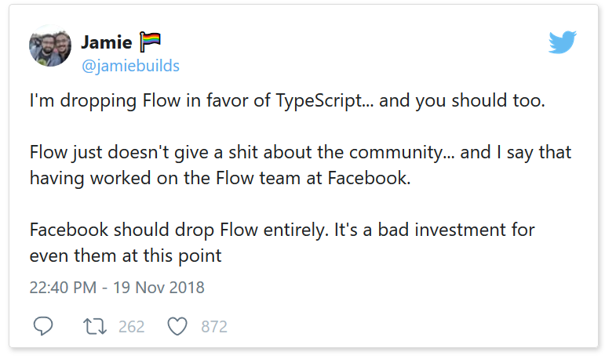
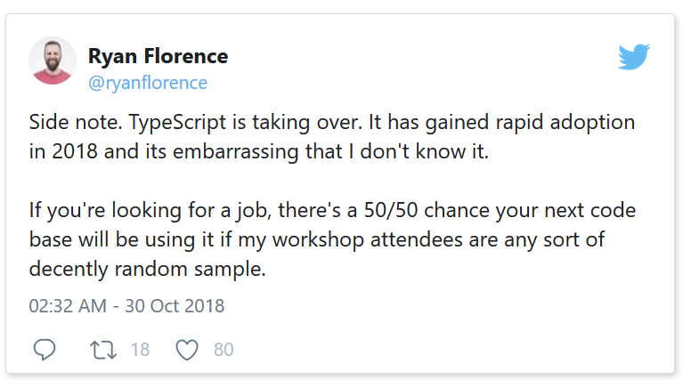
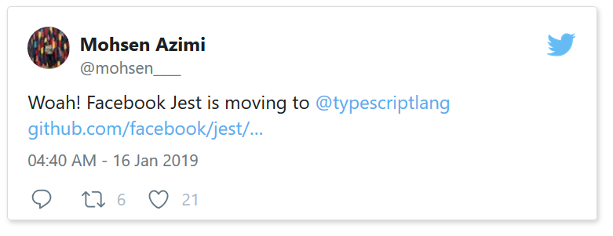
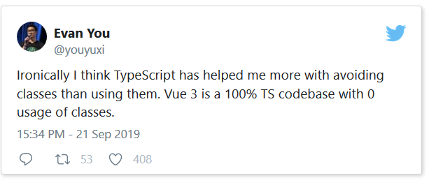
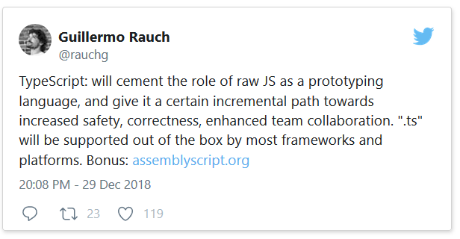
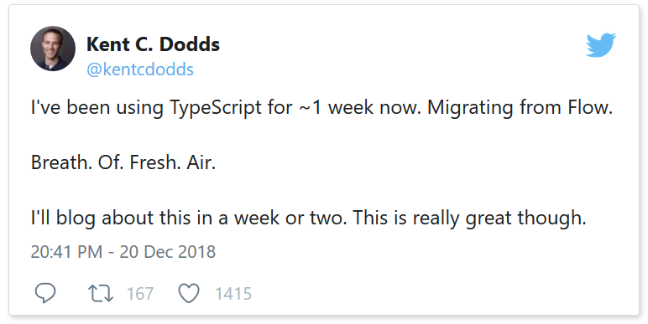
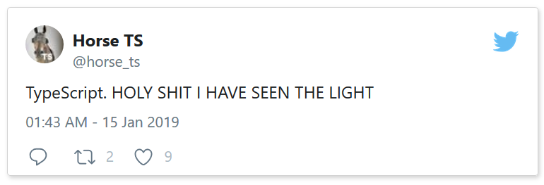

Slide 6
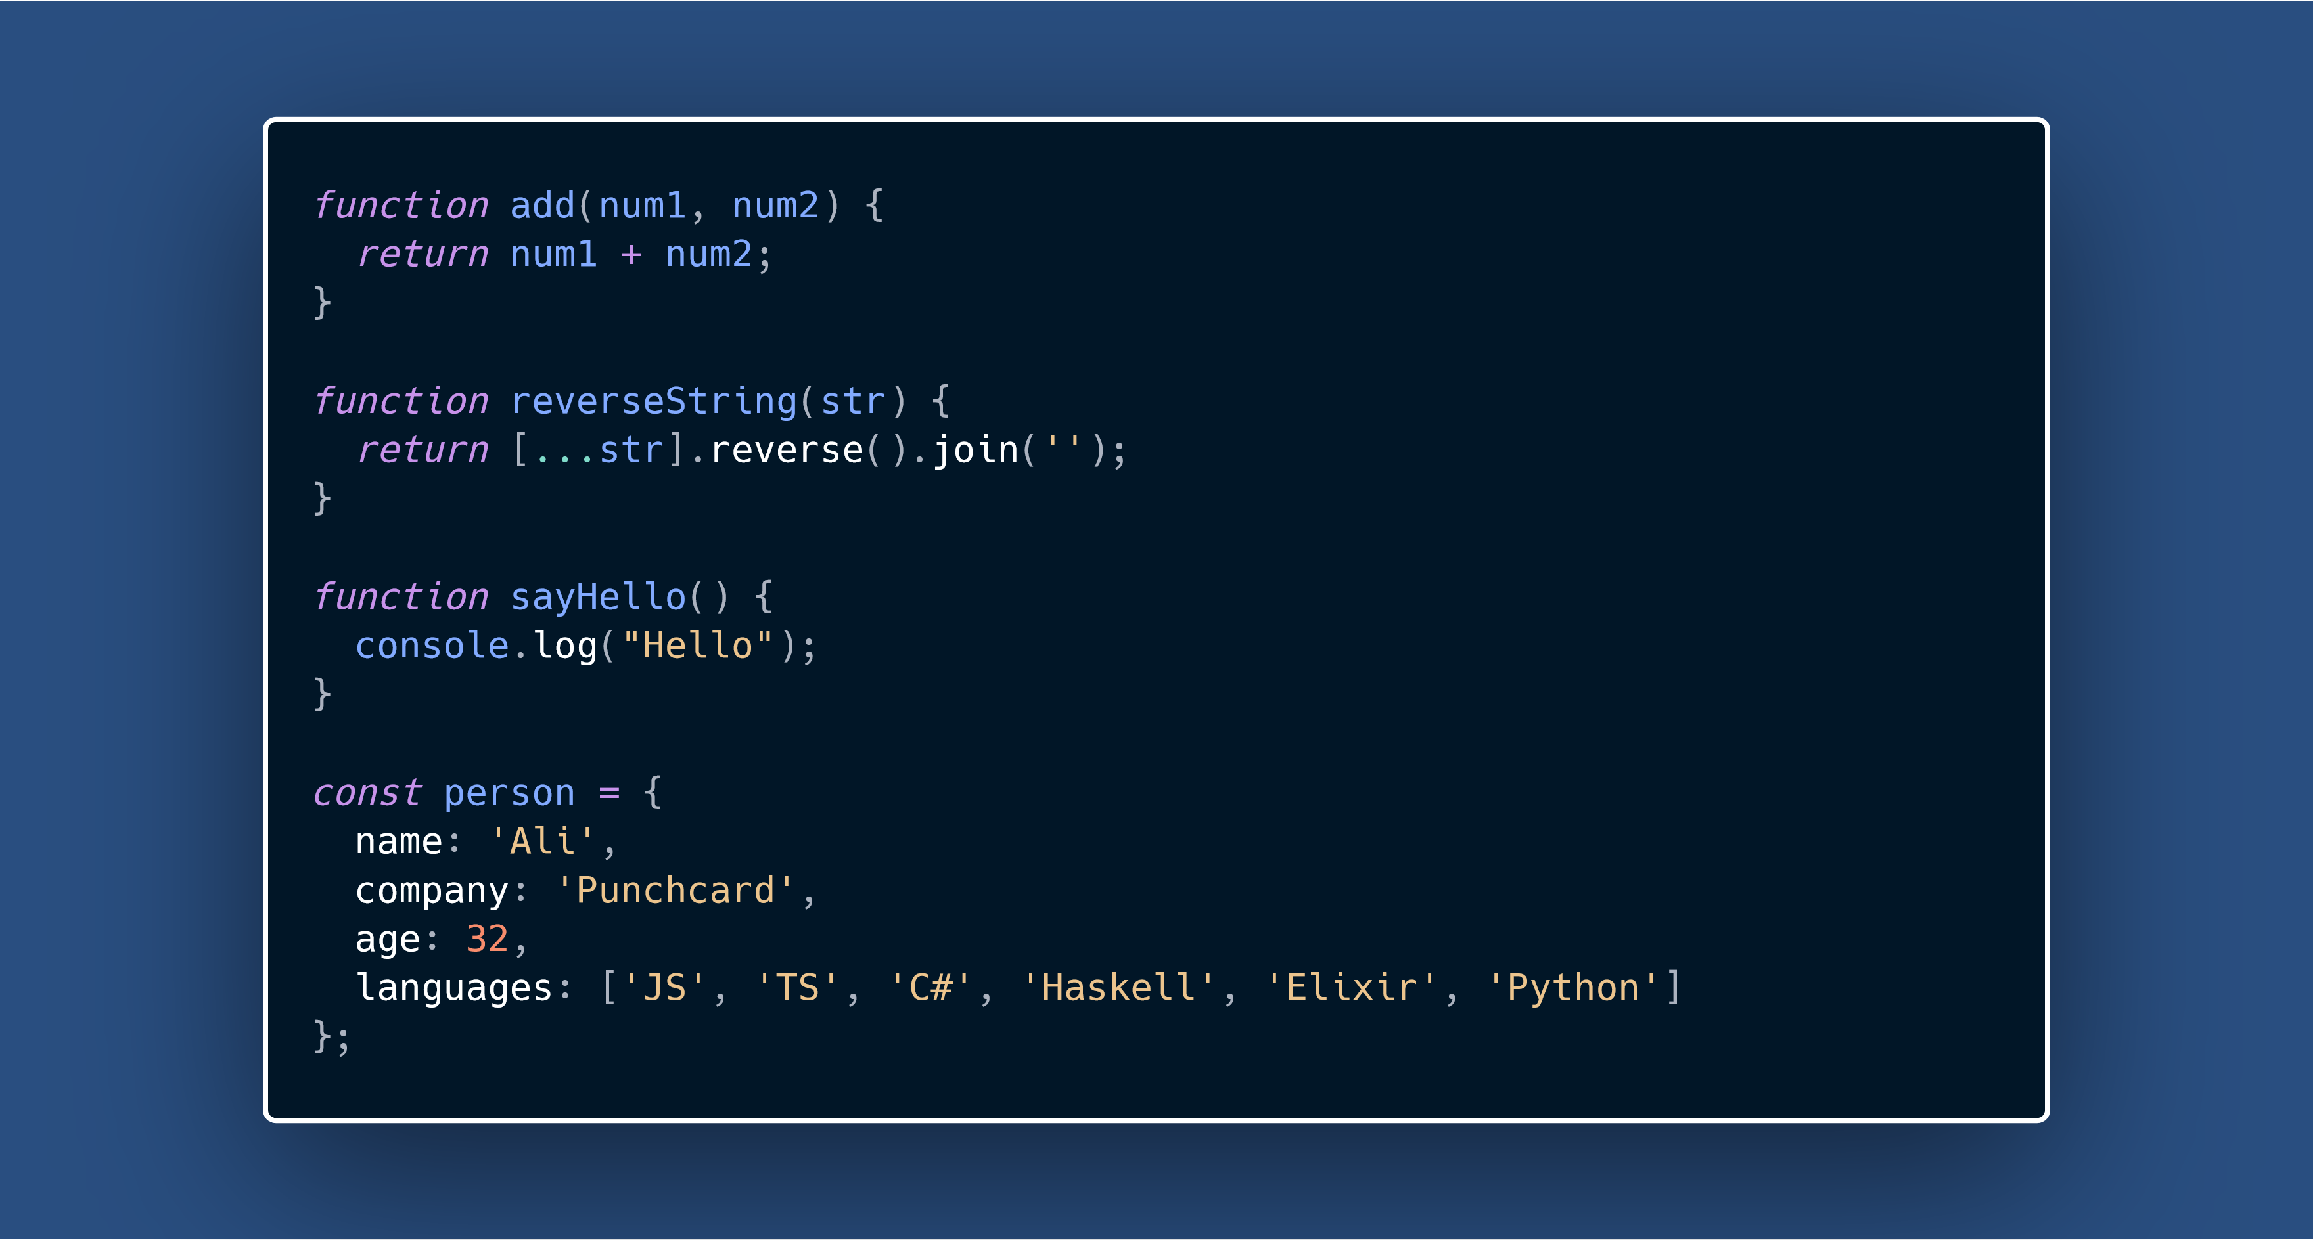

Slide 7
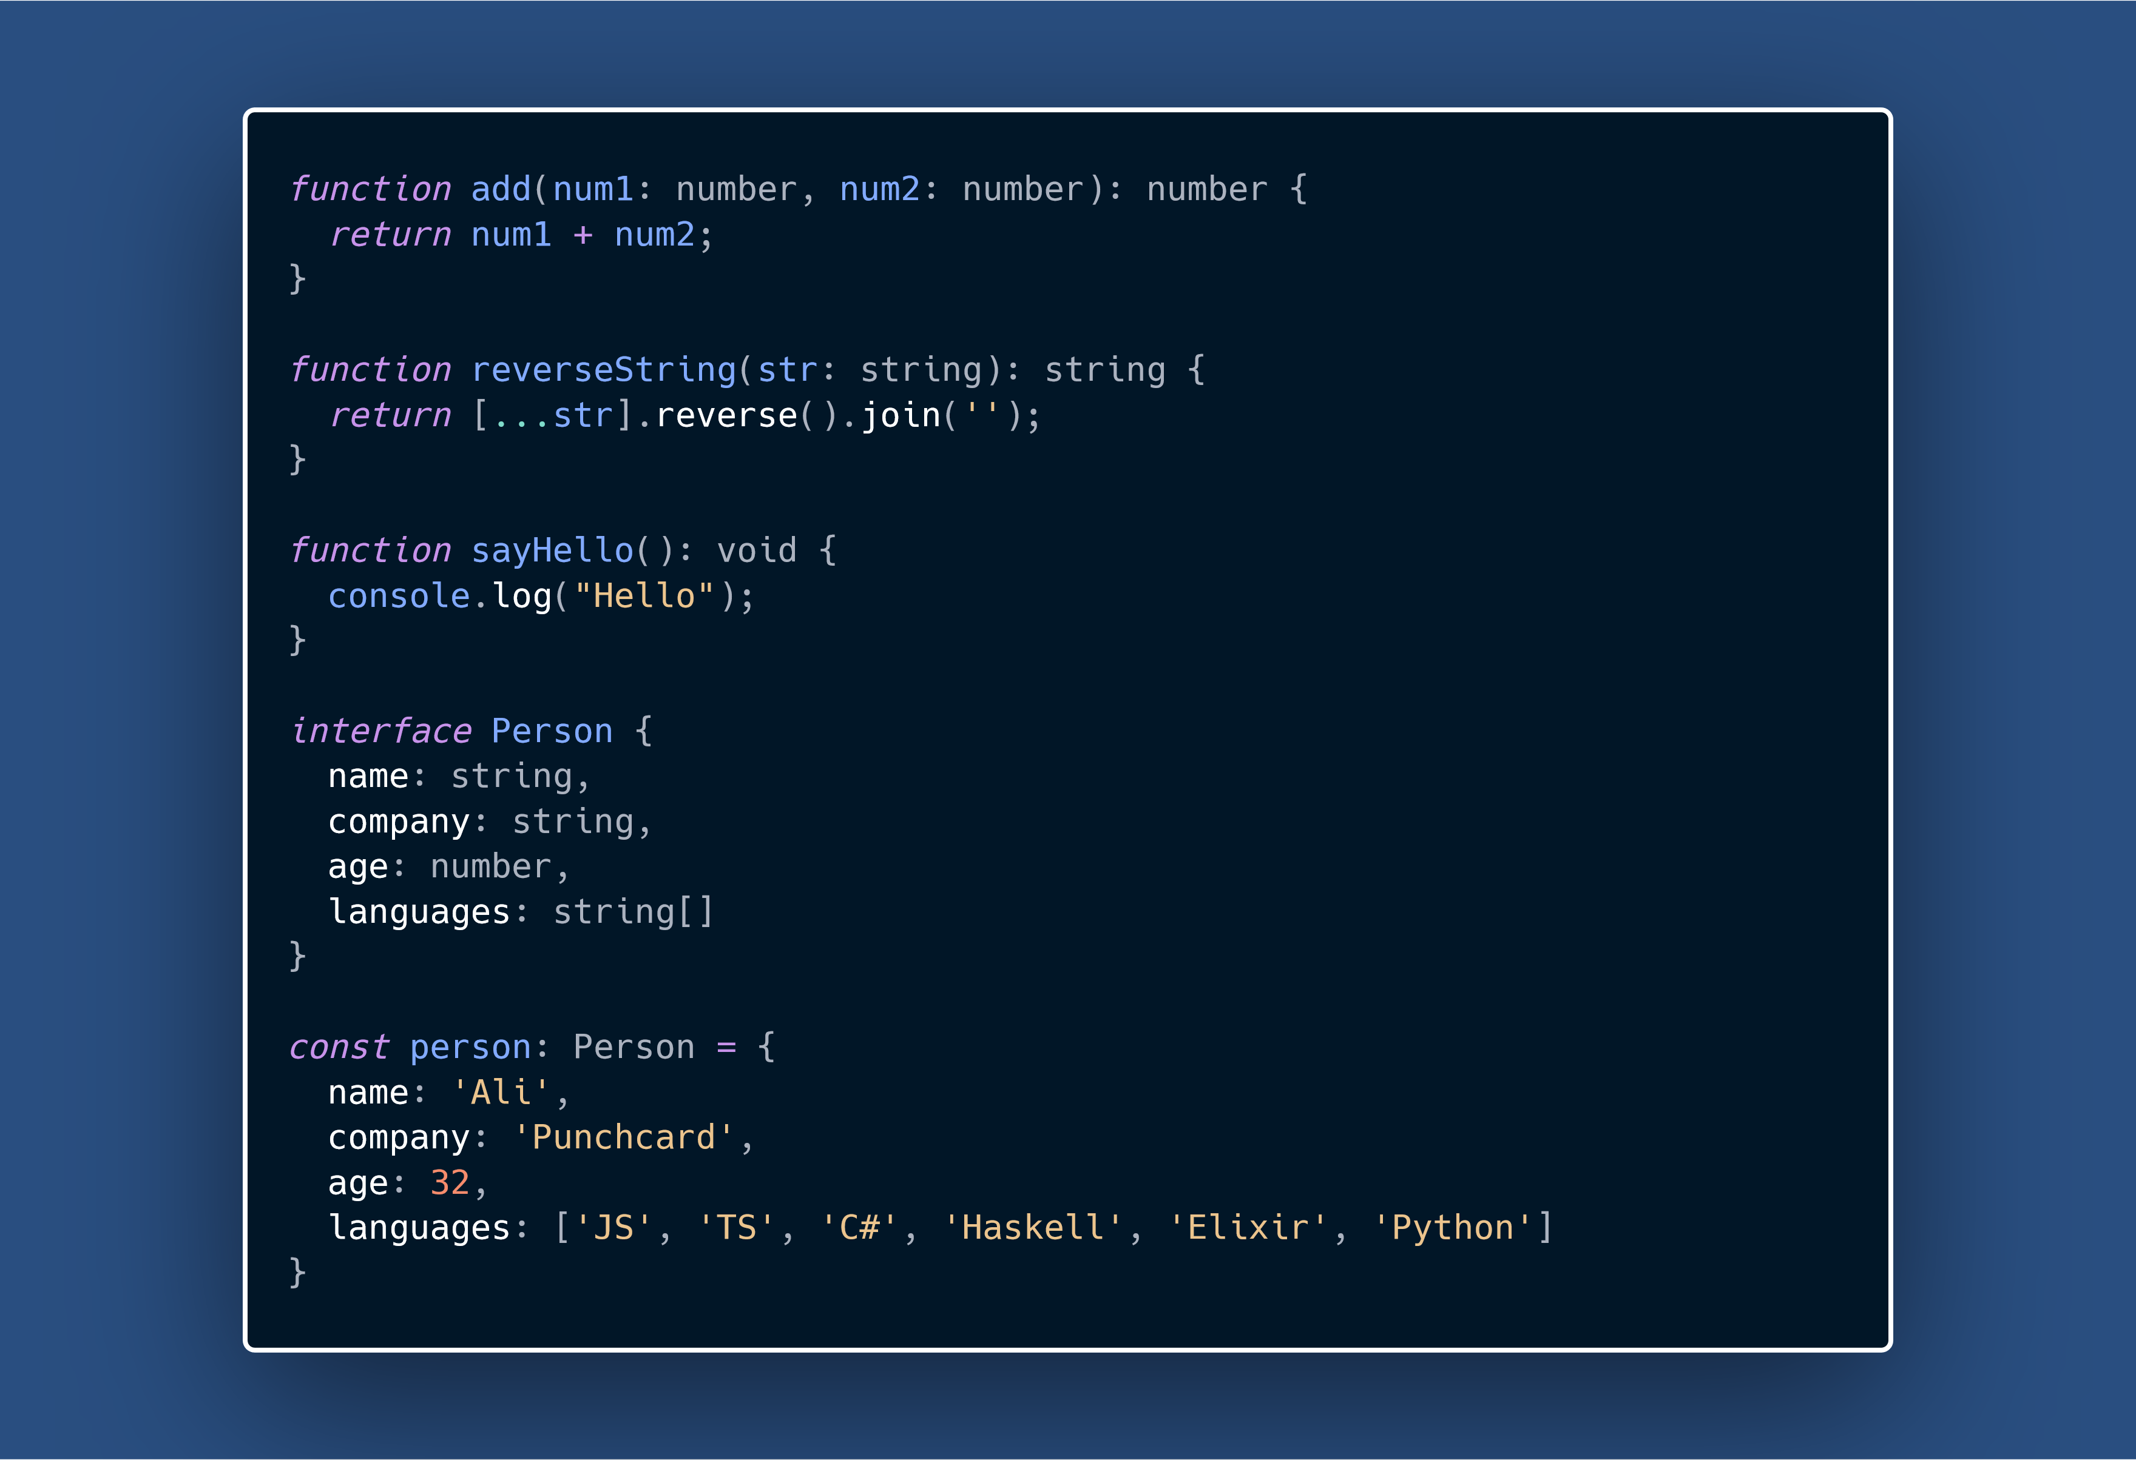

Slide 9
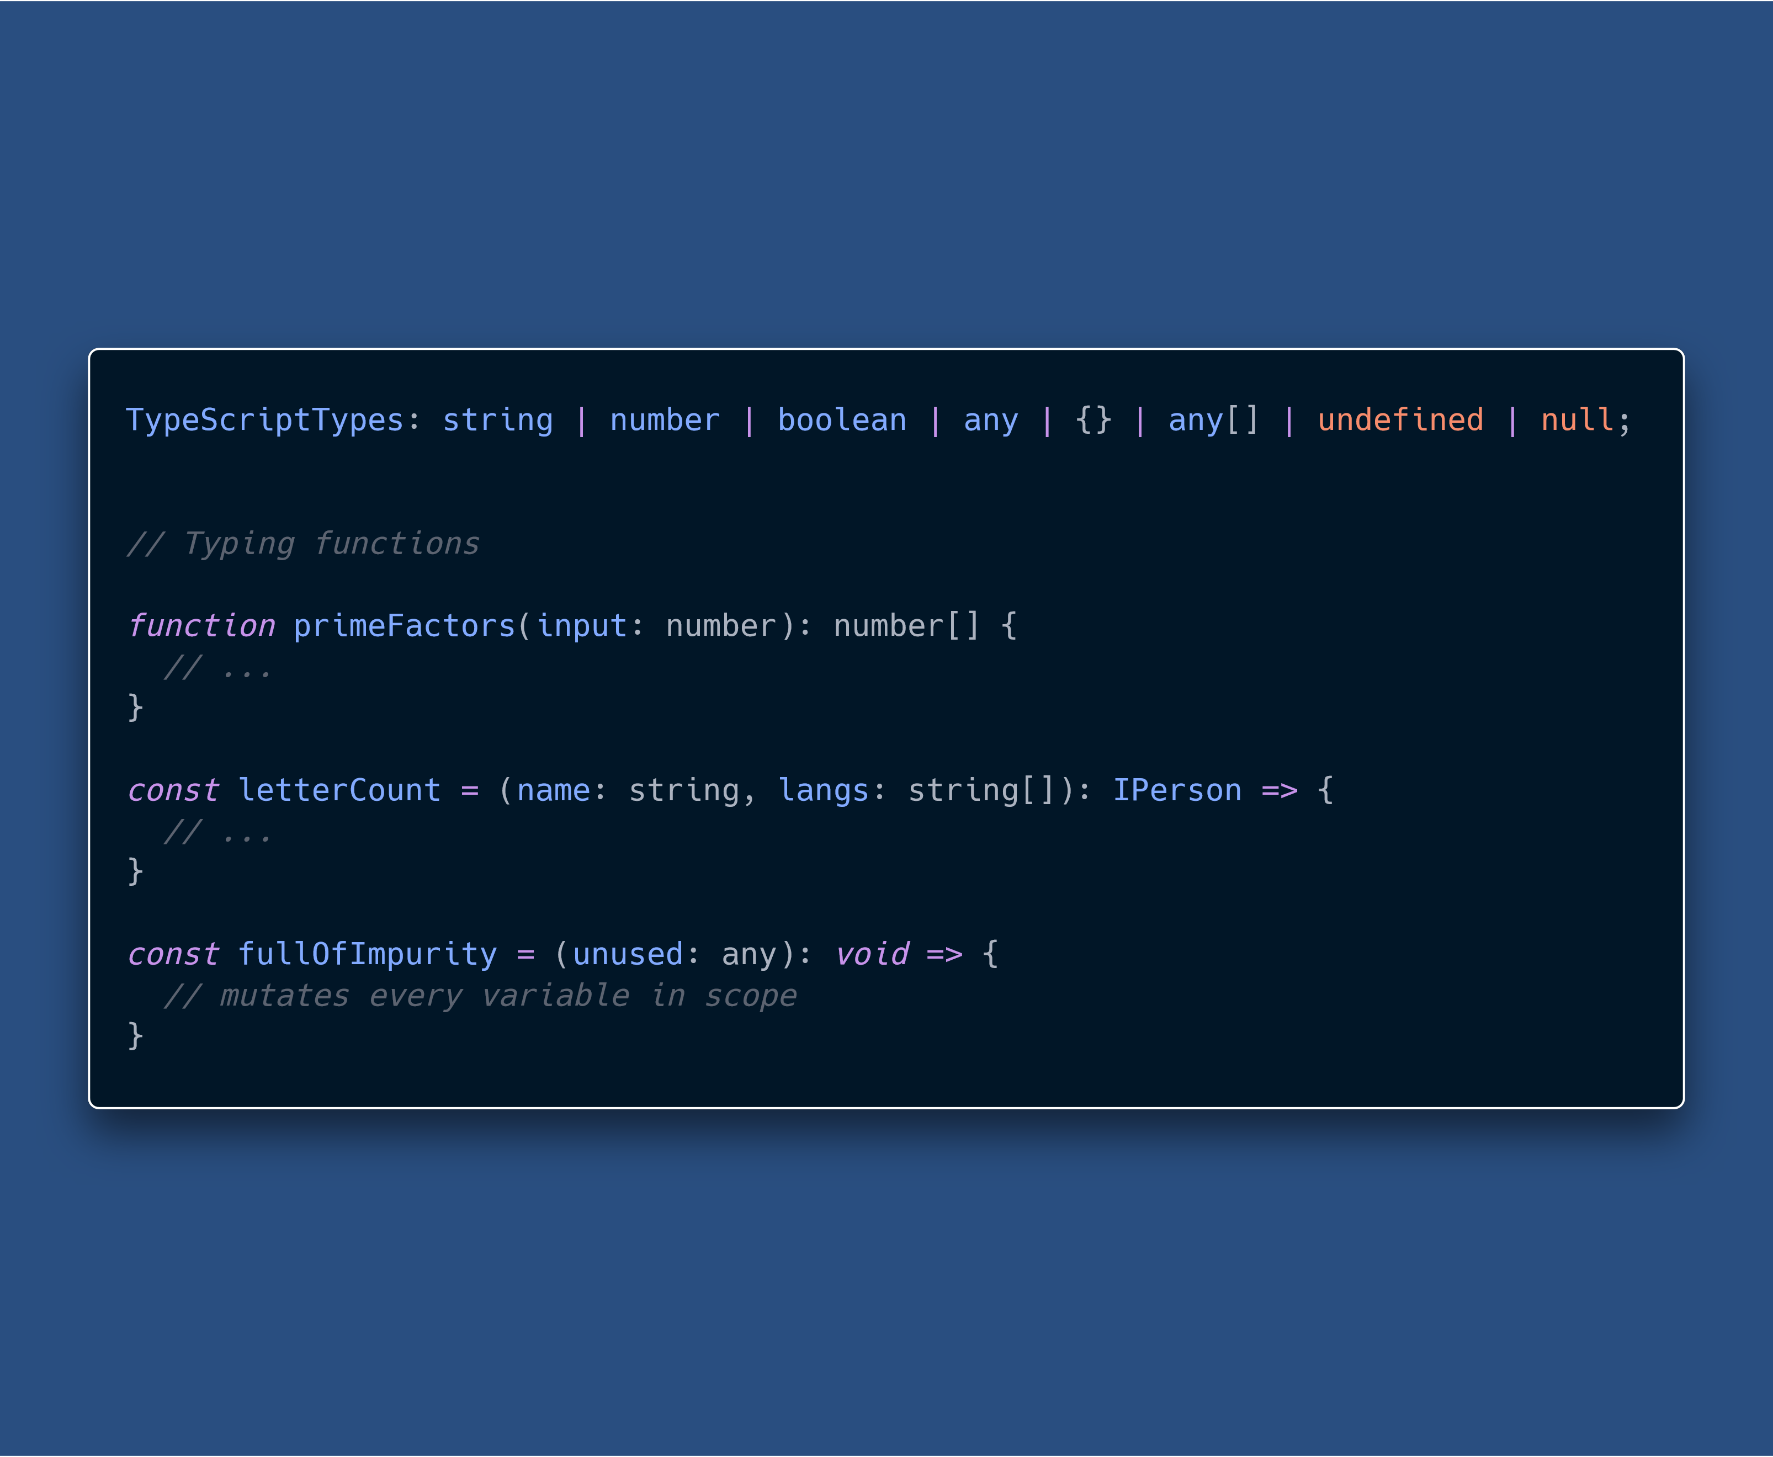
TS Basics

Slide 10
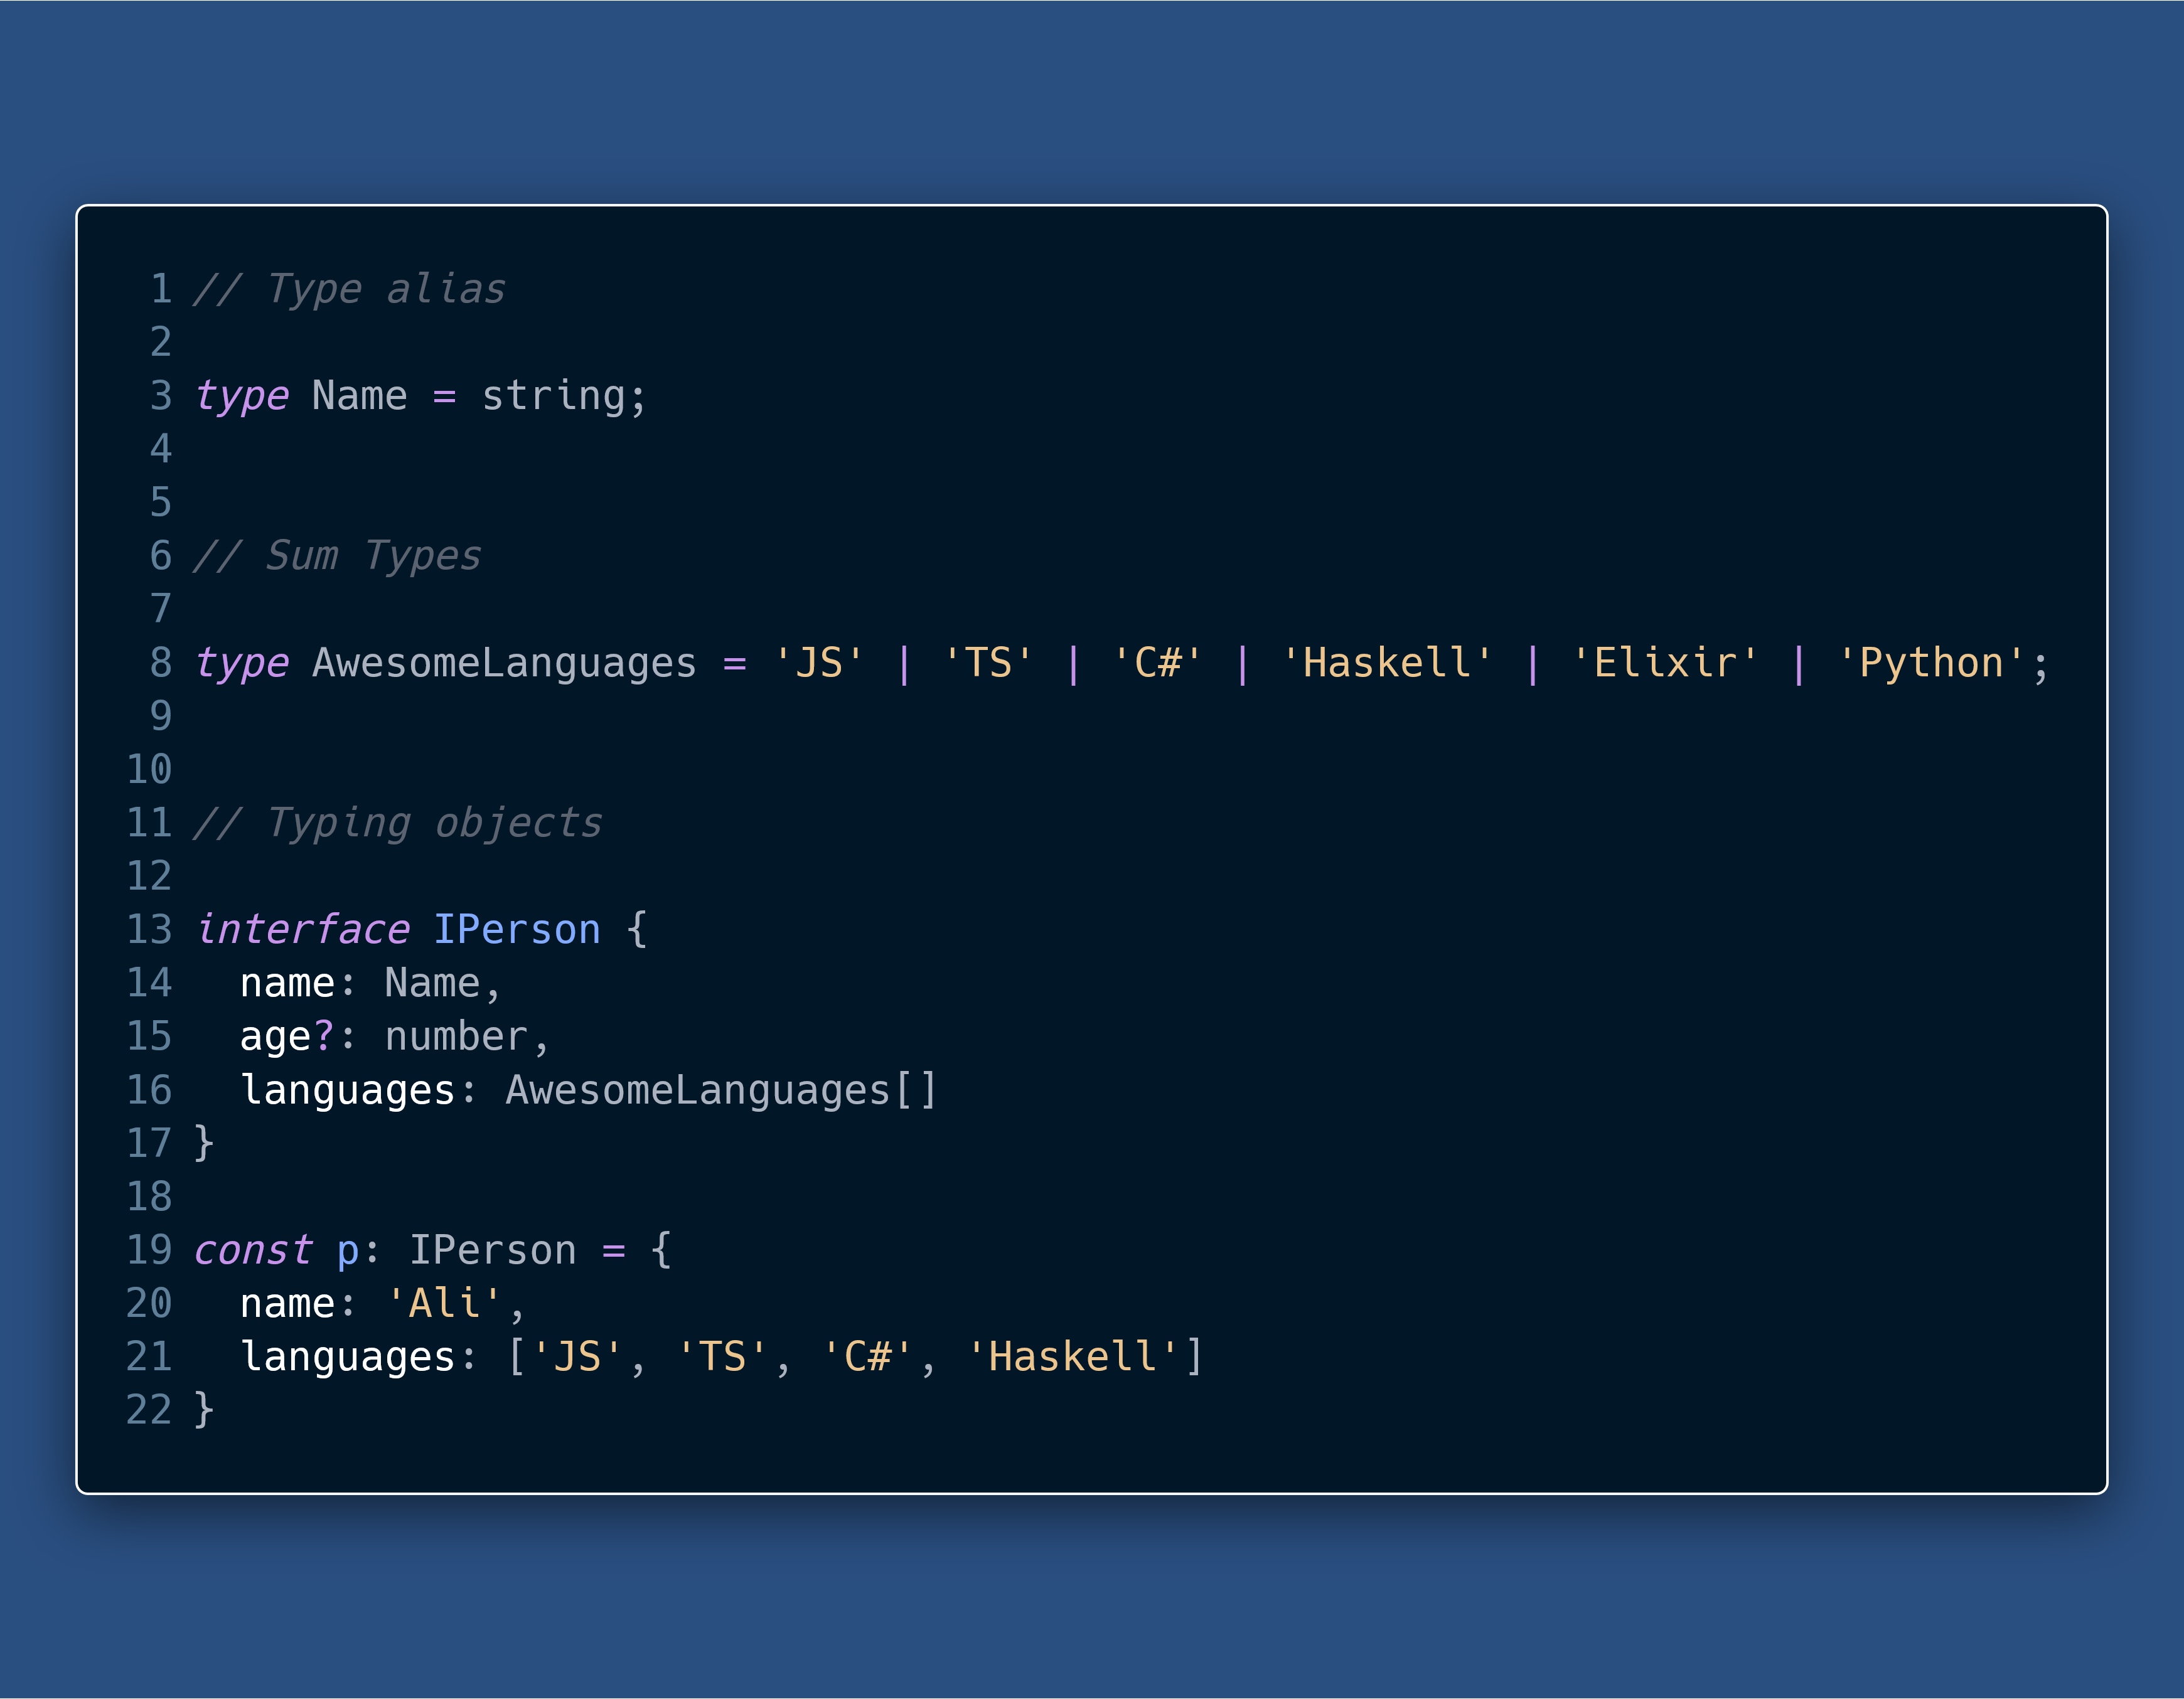
TS Basics
Notes:
Object use duck-typing (structural typing) as opposed to nominal types.
TS also performs Excess Property Checking

Slide 11
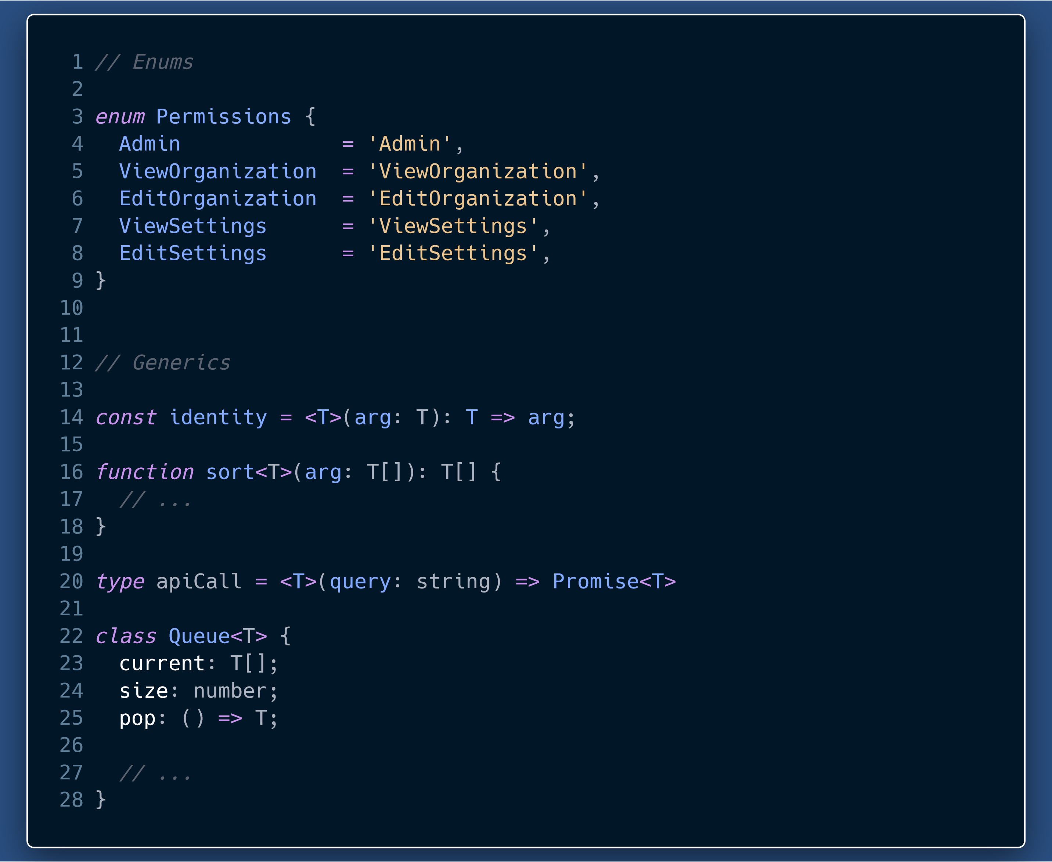
TS Basics
Notes:
Enums allow us to define a set of named constants
Generics allow us to be able to create some code that can work over a variety of types rather than one. Generics are also called polymorphic types

Slide 12
Why TypeScript ?

Slide 13
Why TS?
Readable, easily understandable and scalable code.
Self documenting code
Ease of communication among developers
Maintenance & Refactoring
Thinking about types in your program makes you a better developer
Static analysis and fewer run-time errors
Editor Superpowers
Union Types

Slide 14
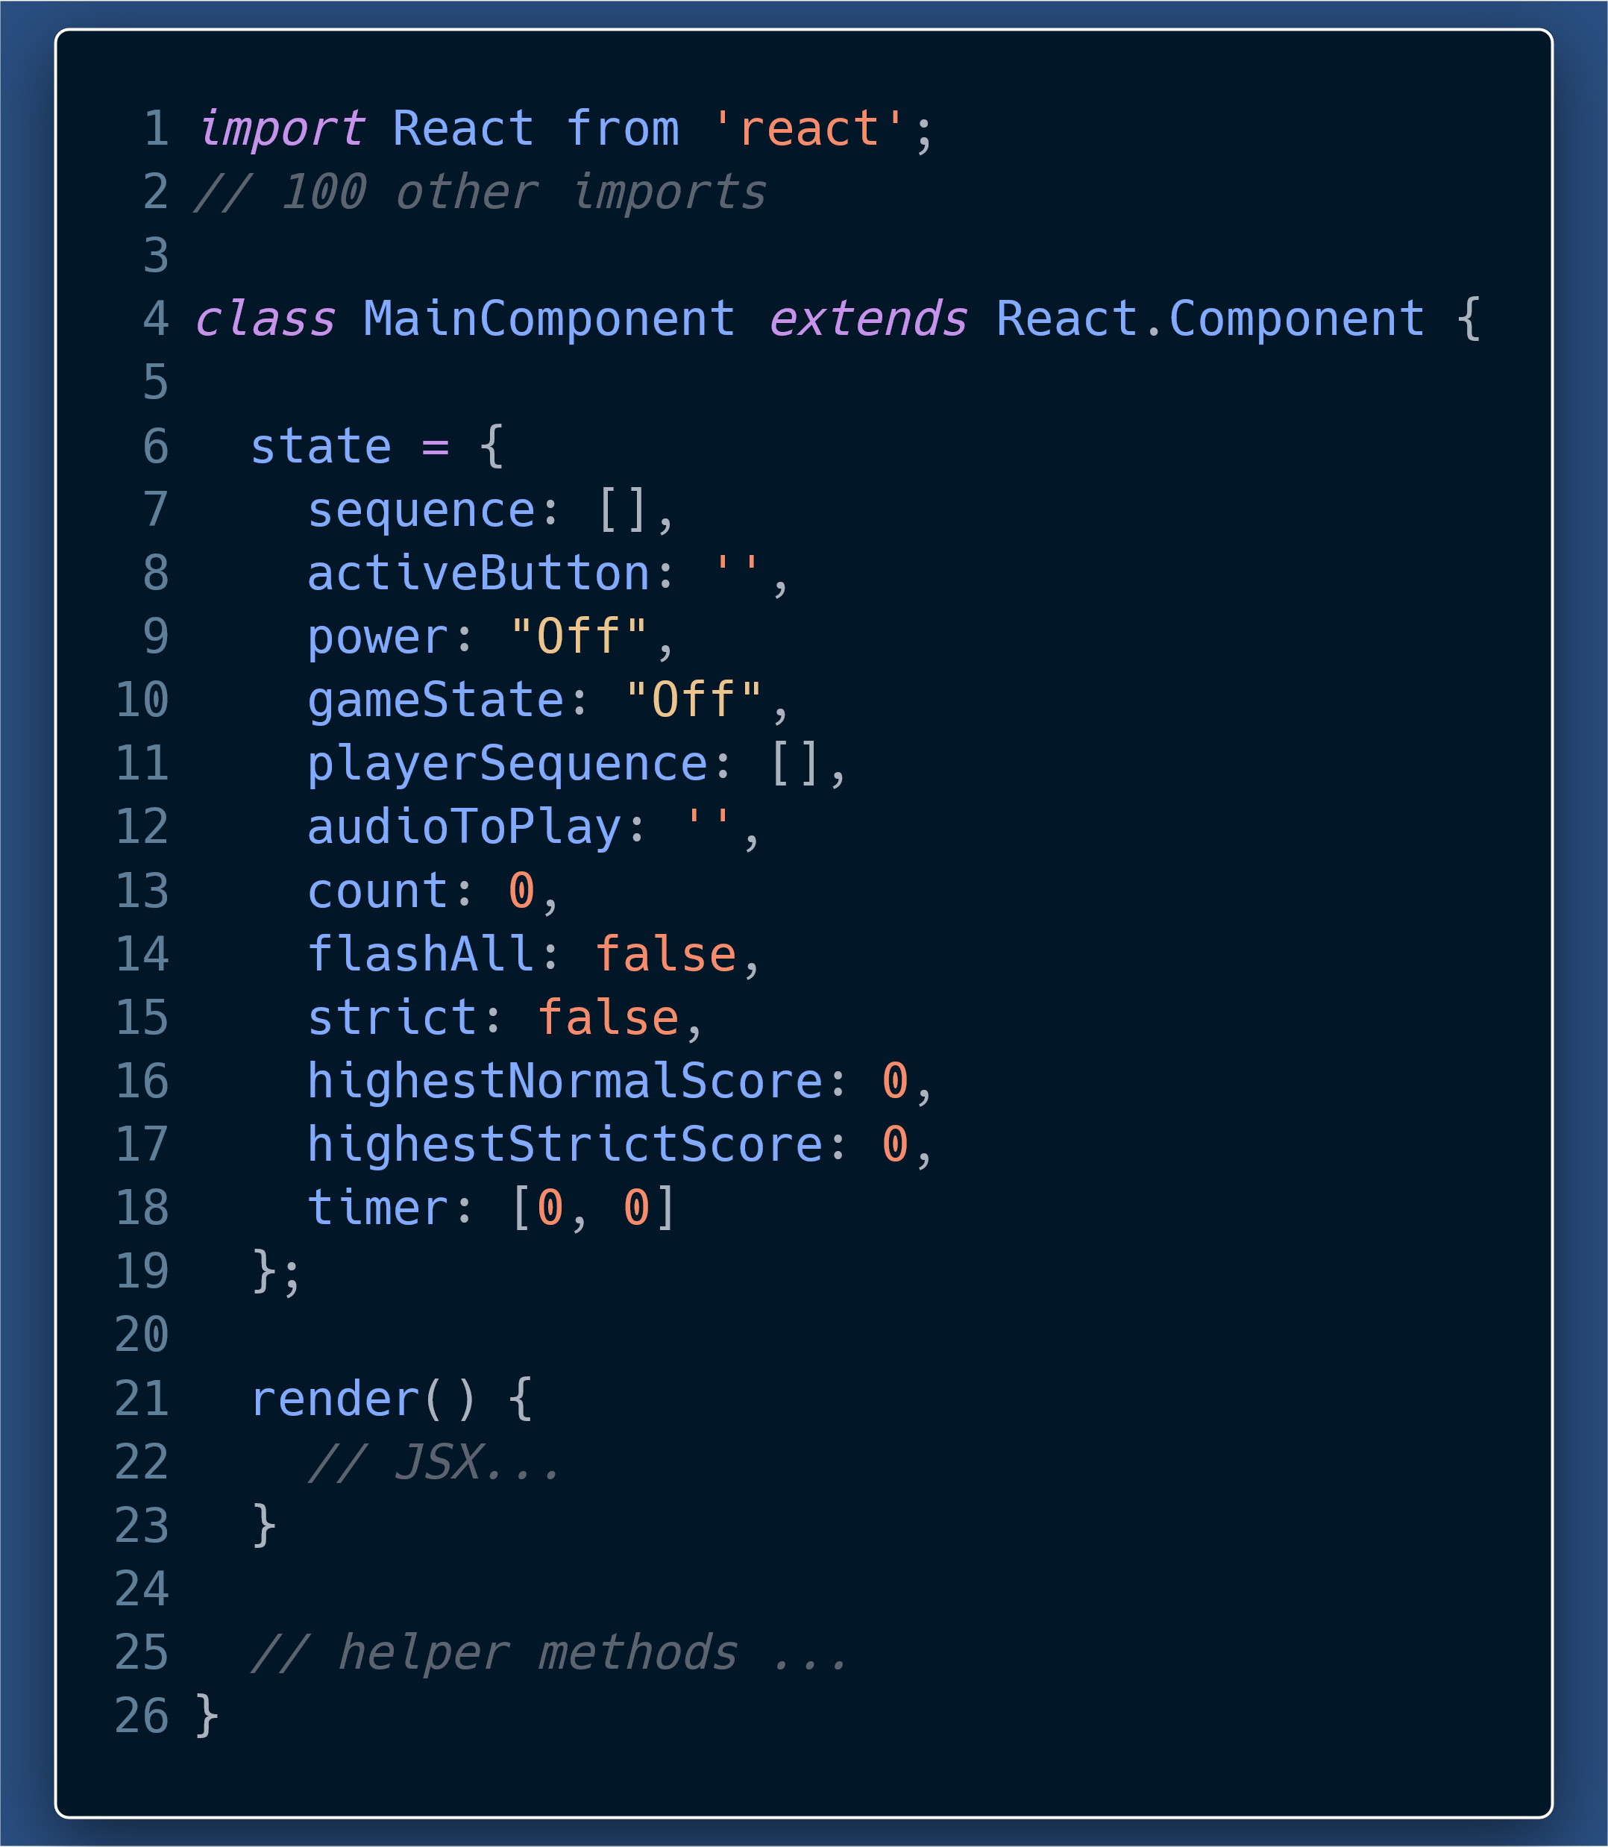
How many and what type of props does this component take?
What is each state item supposed to be?
With JSX and helper methods included, this component will be a lot harder to decipher for a first time or a long-lost reader (me after one month).

Slide 15
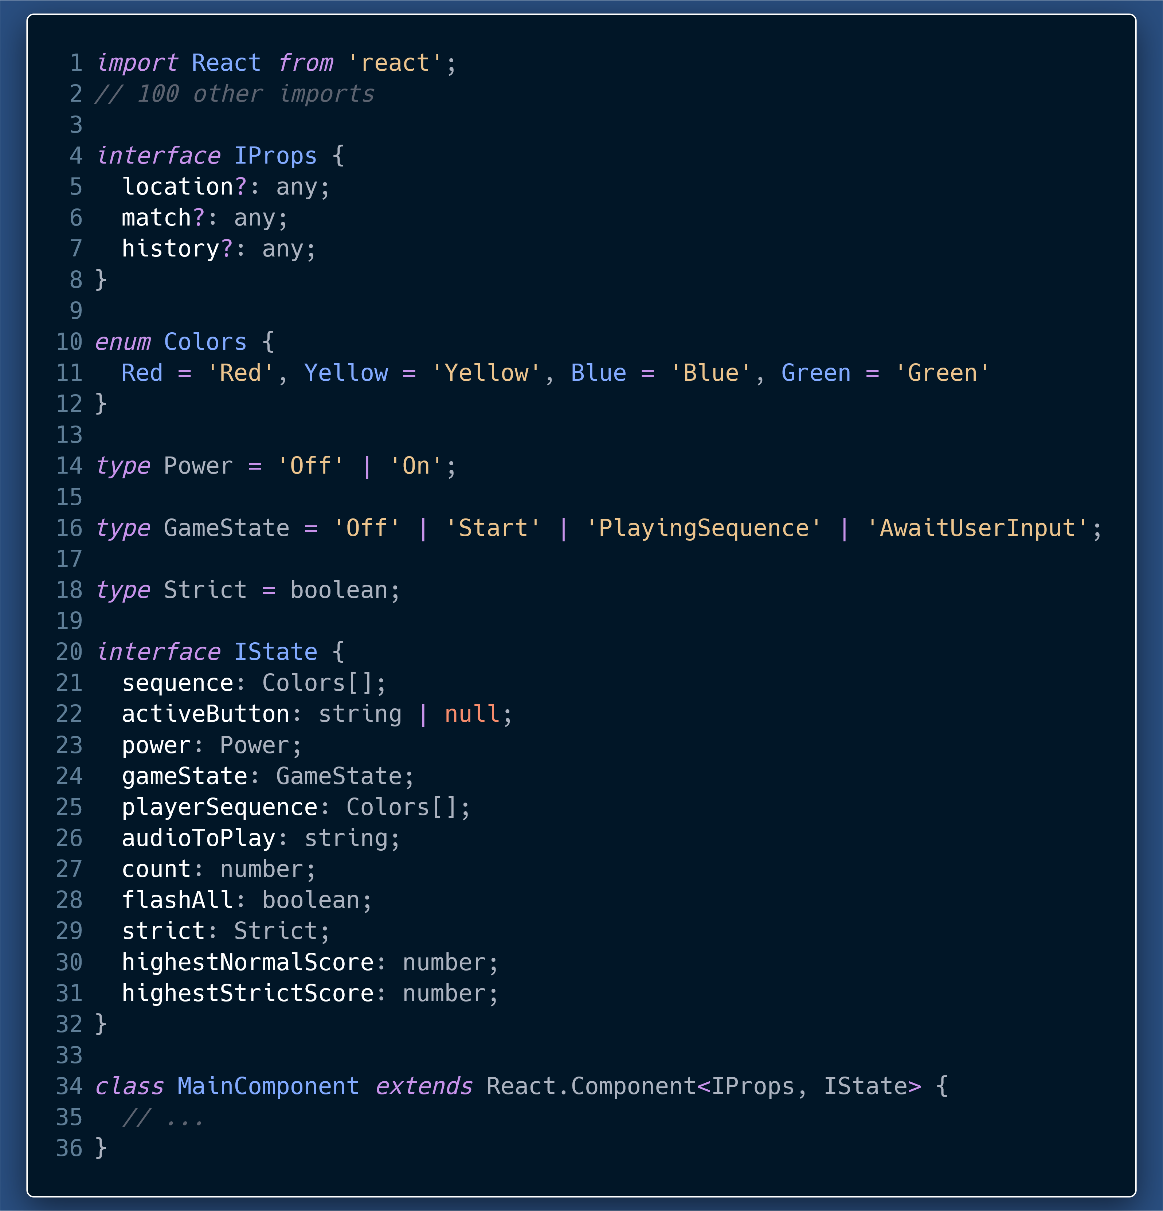
We can now clearly see the:
Exact props and types of props.
Number and types of each state property.
The best part is that the Code itself is acting as documentation.
Types add a layer of documentation on top of JS code.

Slide 16
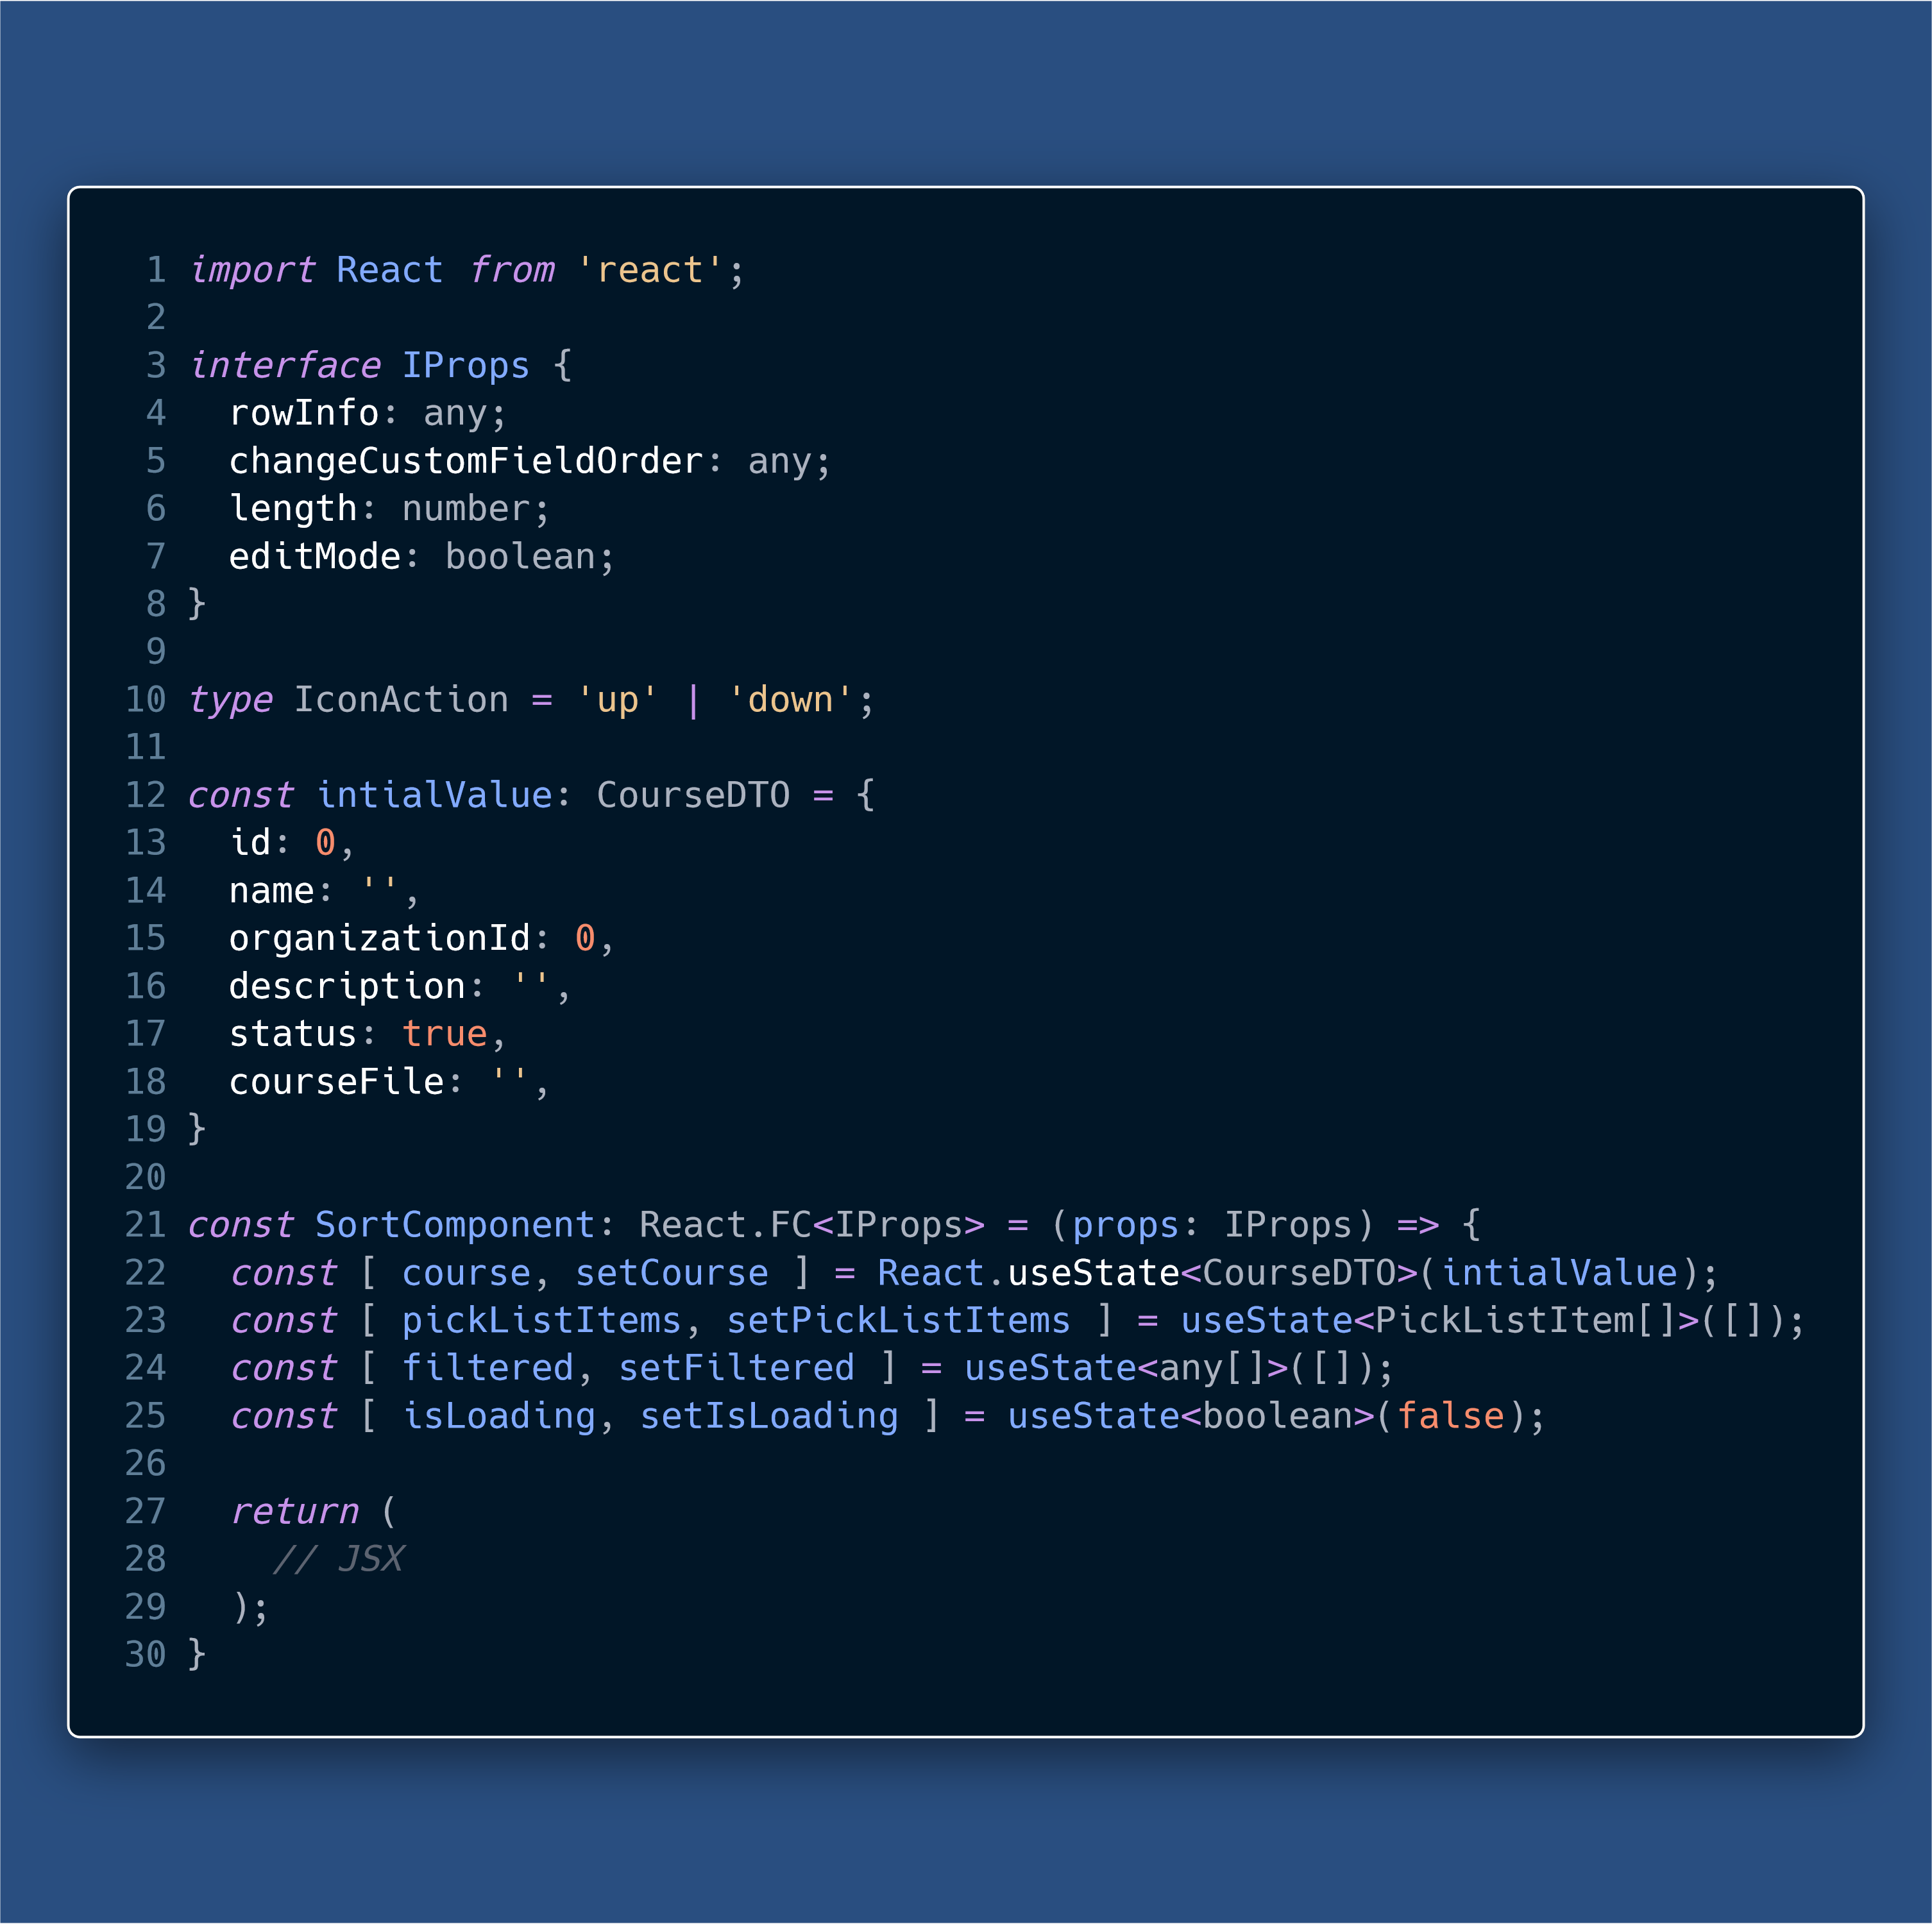

Slide 17
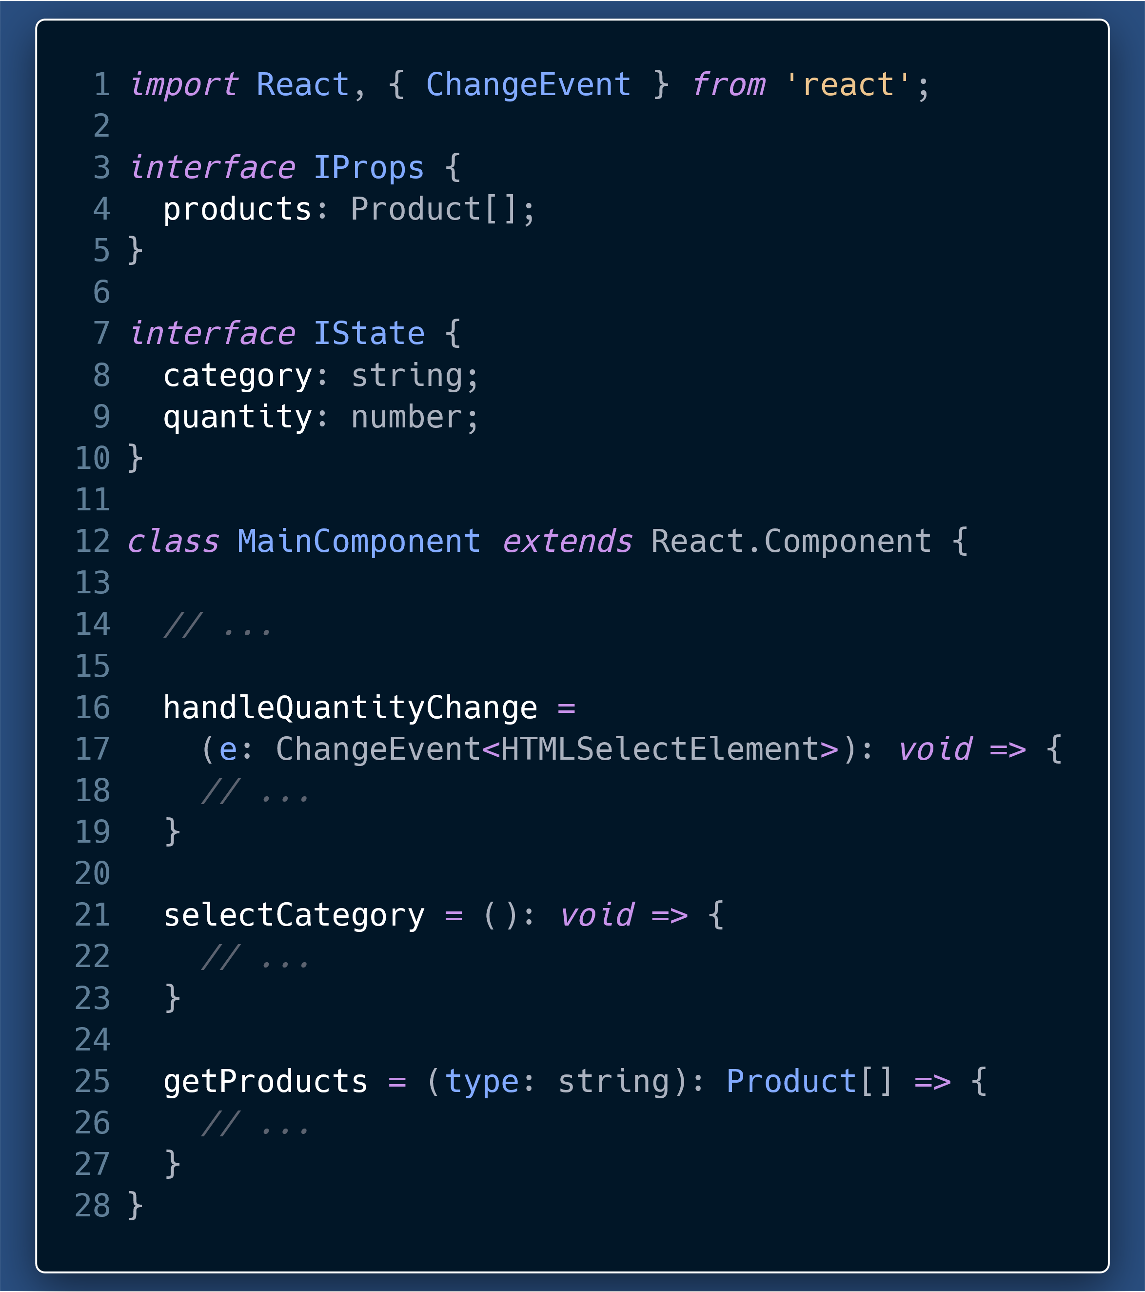
Typing your functions and helpers
promotes “Design by Contract”
Helps identify things like
pure functions from those with side-effects.
The arguments a function takes, what is its return type.
Helps during refactoring where a developer instantly knows the purpose of a function, just from reading types.

Slide 18
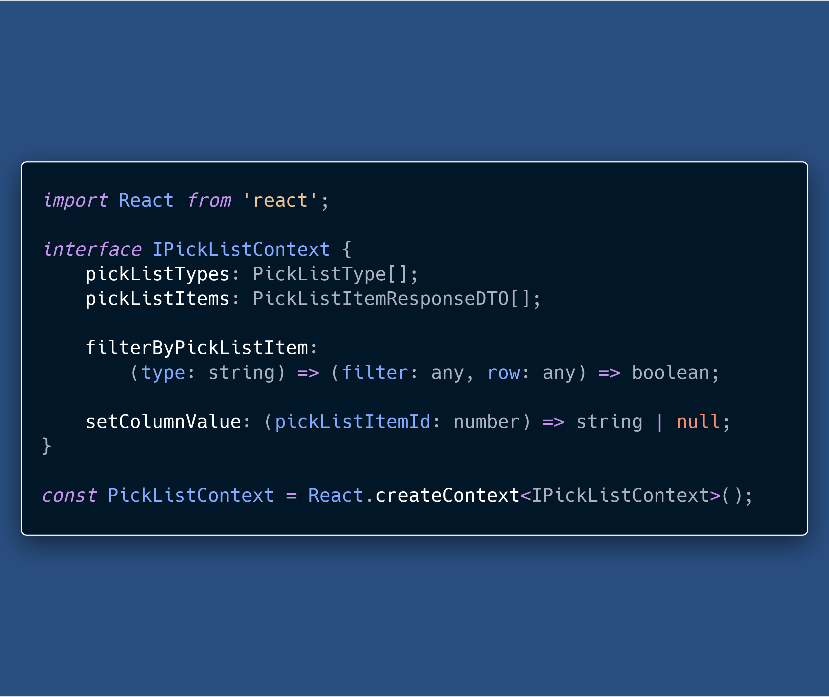
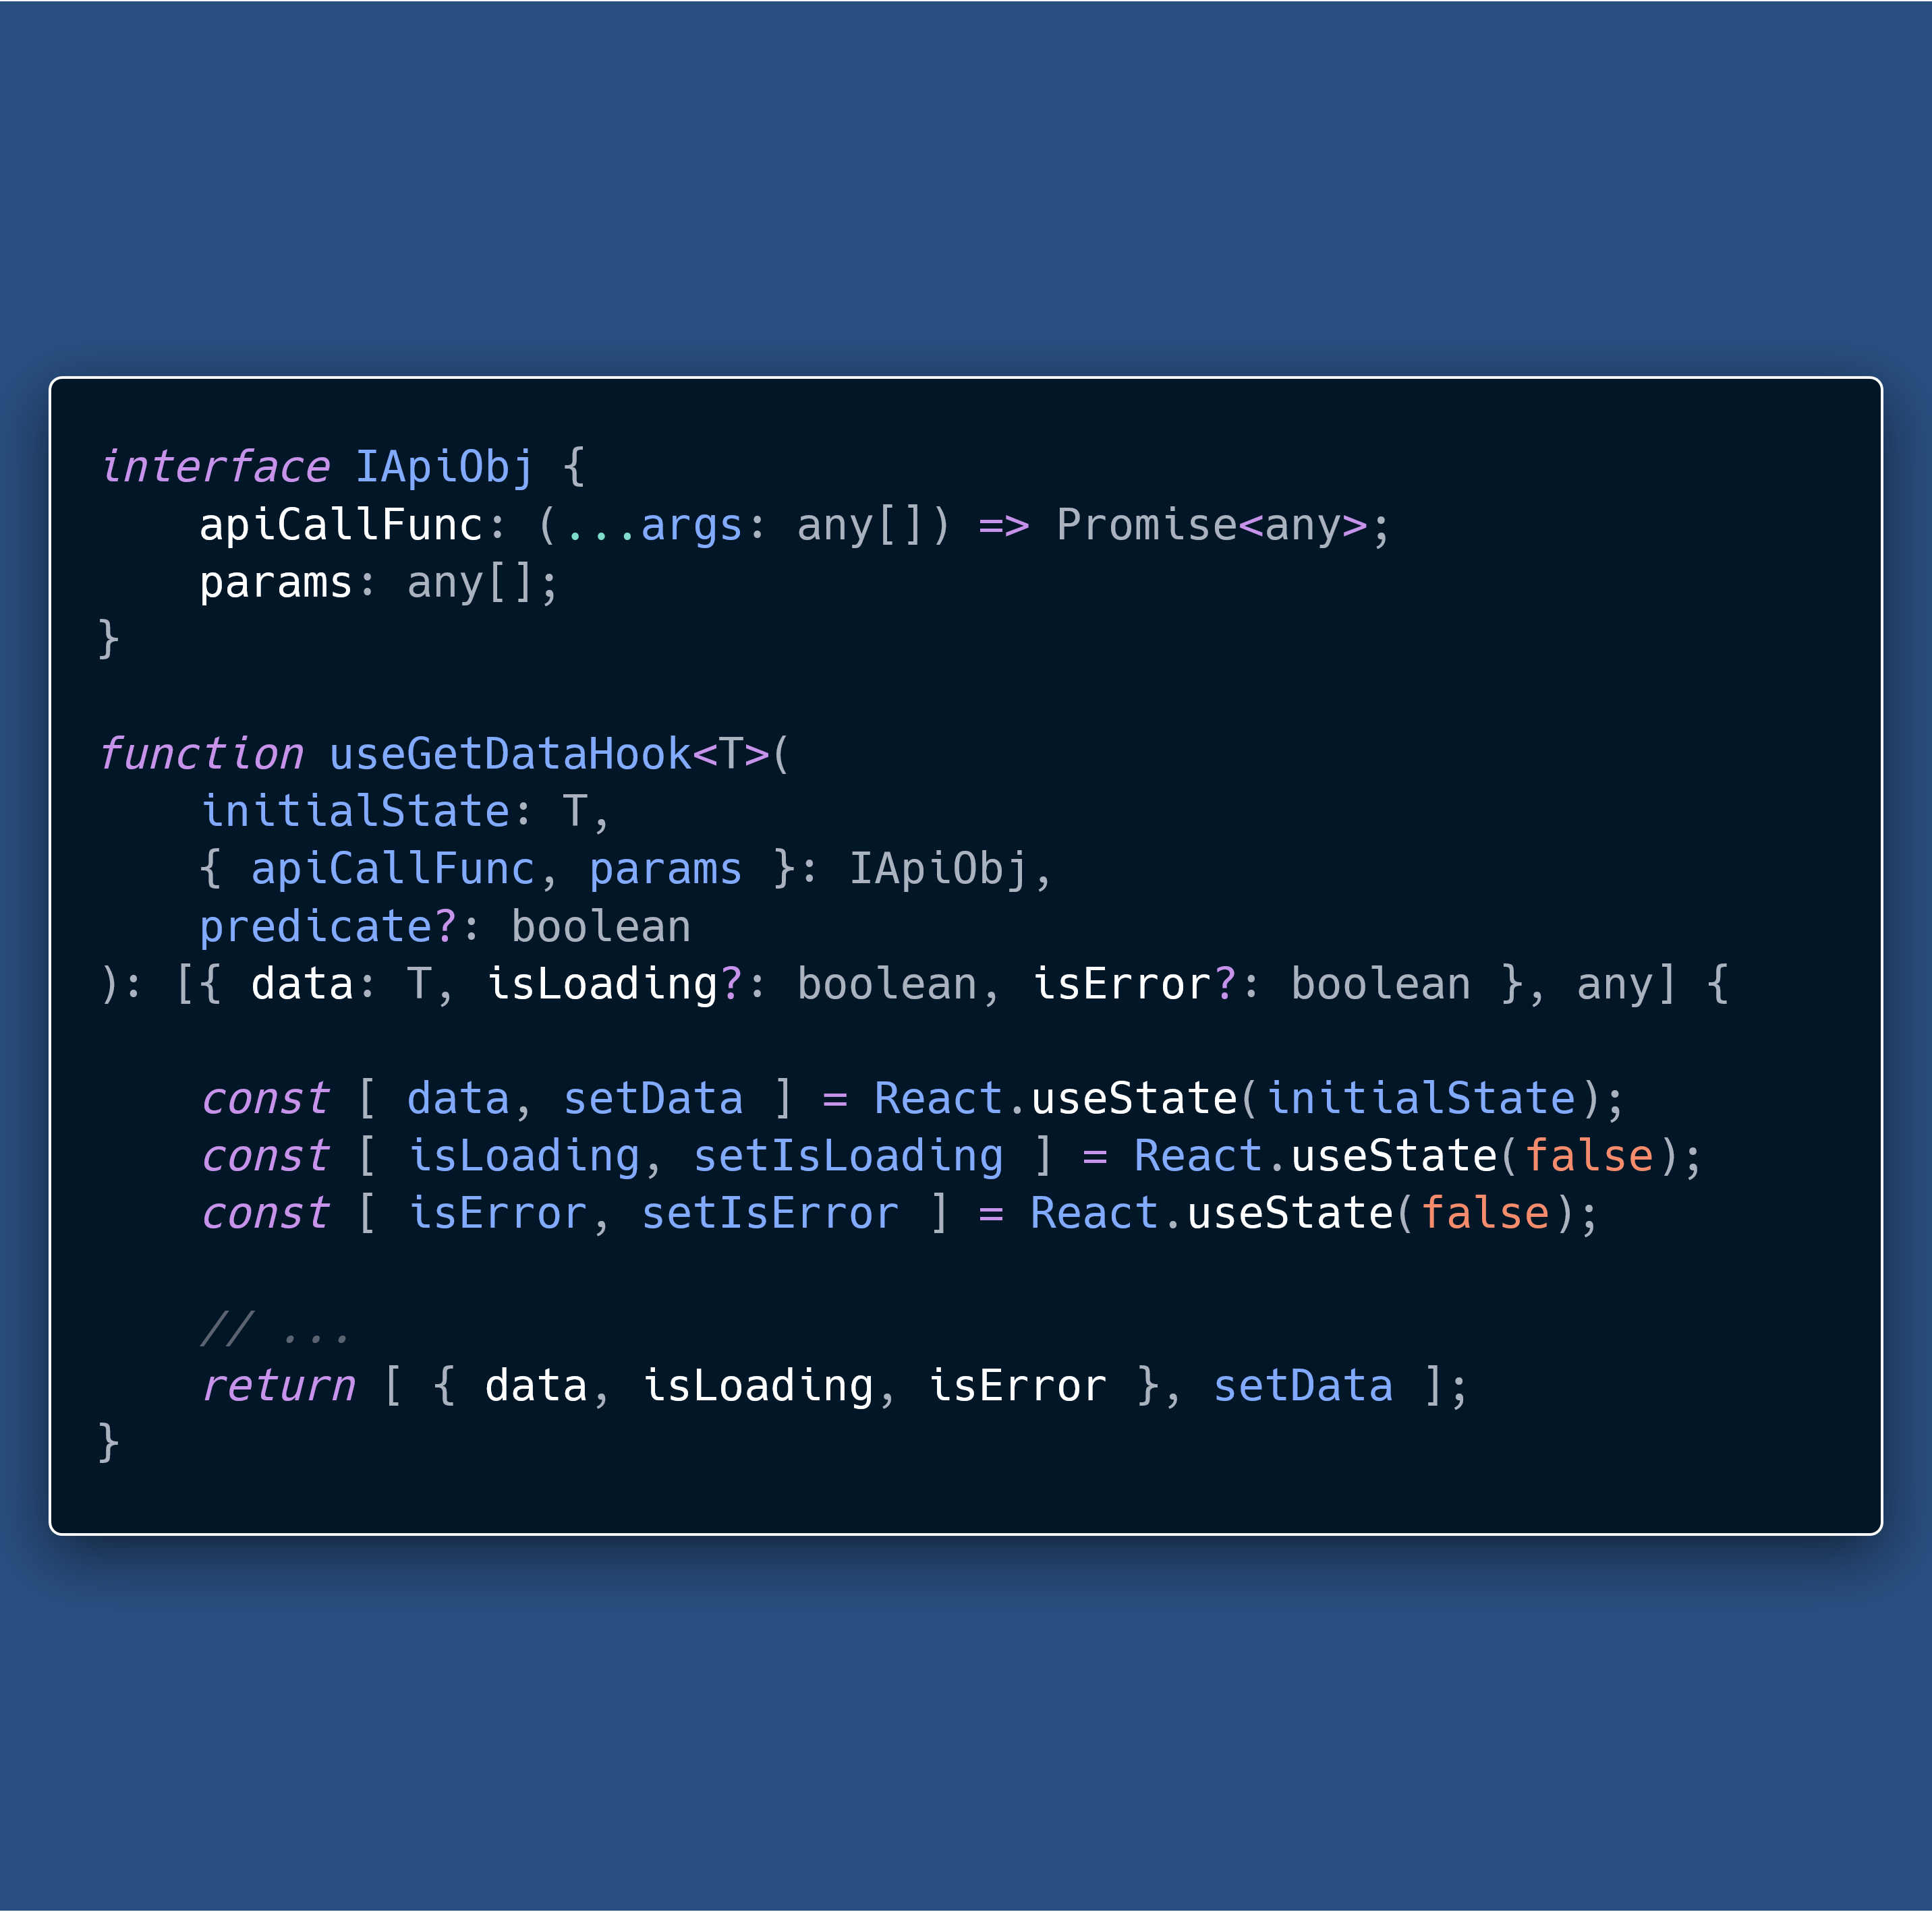

Slide 19
Run-time errors to Compile-time errors
TypeScript catches many of the errors, that would be JavaScript run-time errors, at compile time.
This works without specifying types for most of our code, because TS Compiler can infer types.

Slide 20
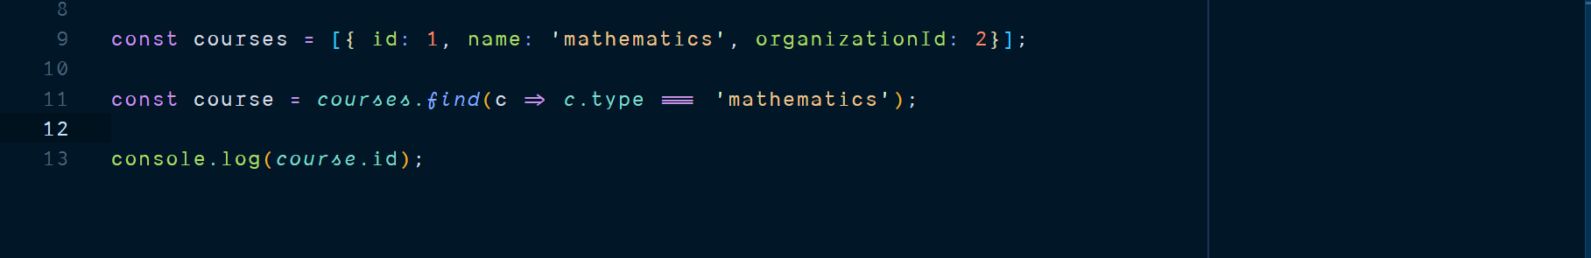

Slide 21
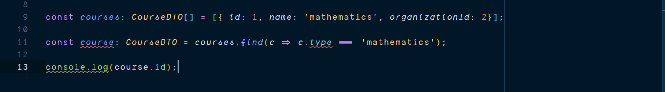

Slide 22
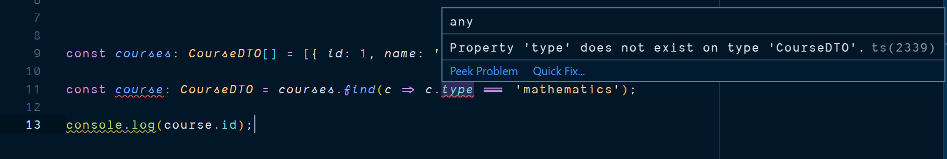

Slide 23
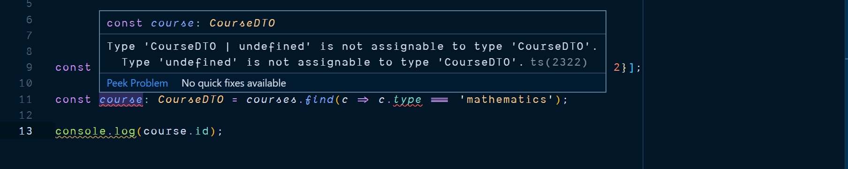

Slide 24
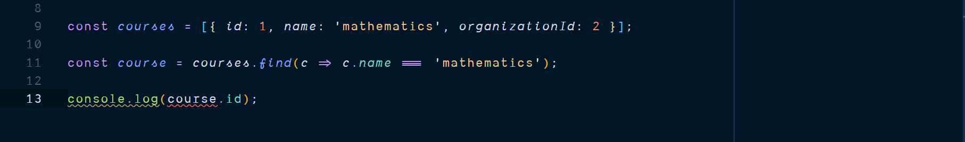

Slide 25
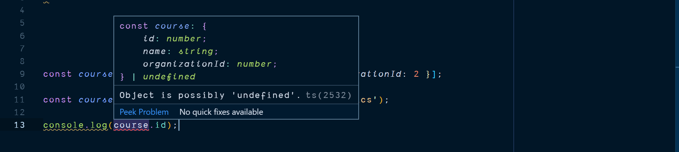

Slide 26
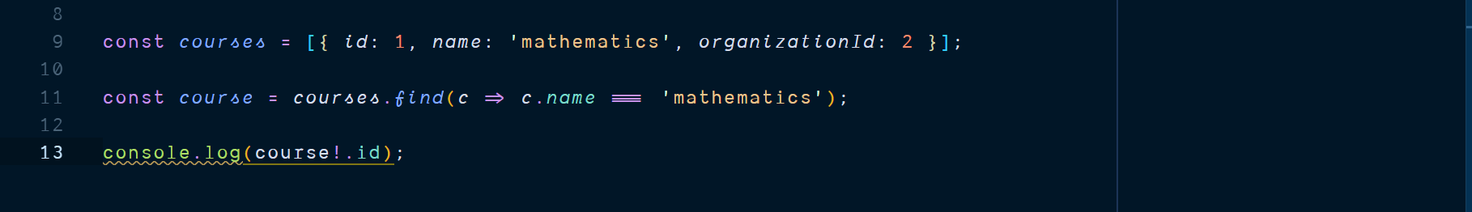
Notes:
assertions

Slide 27
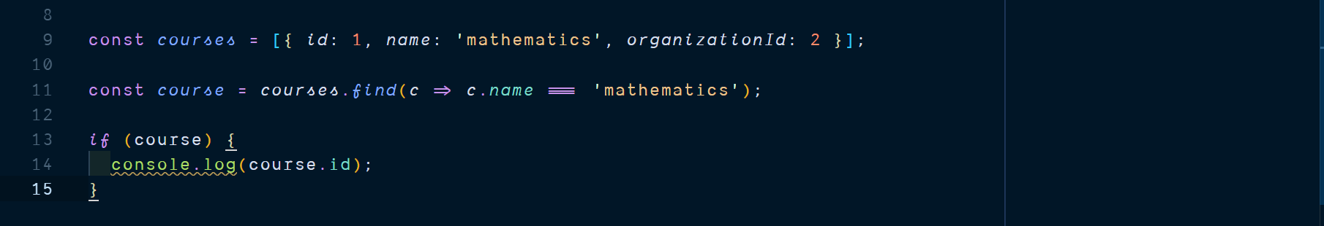
Notes:
Add Type Guards as well

Slide 28
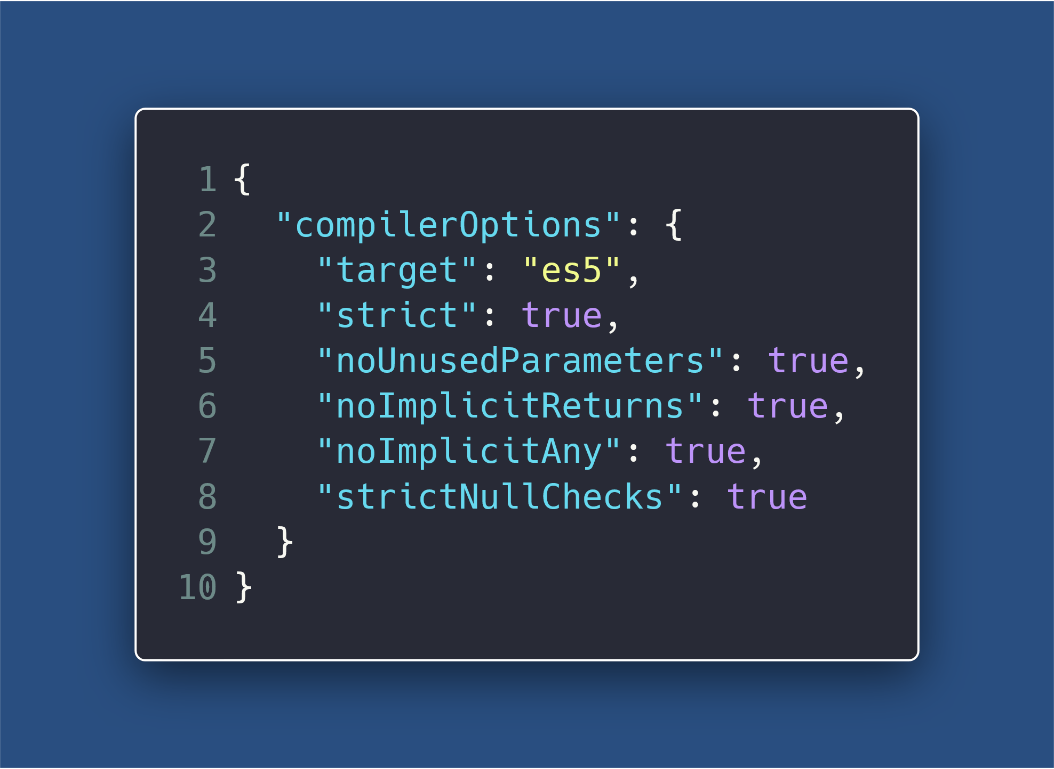
Notes:
allowJS and checkJS TS compiler options
--strictFunctionTypes
Explain –strict

Slide 29
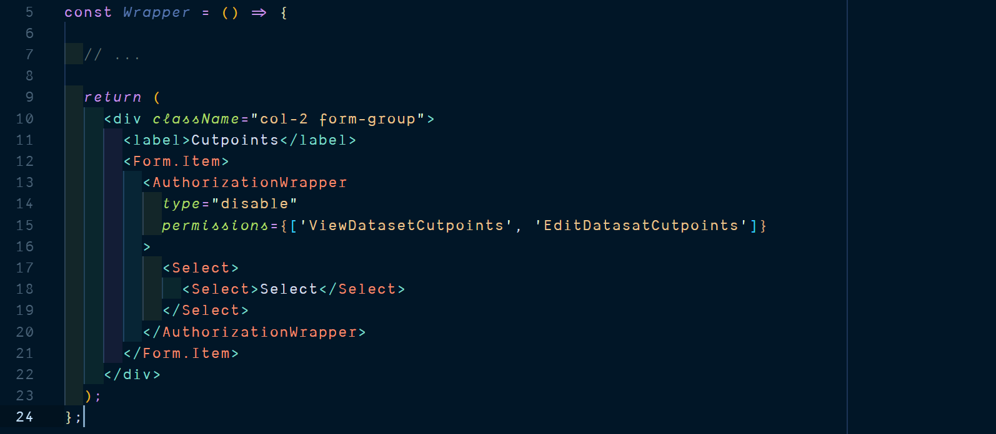
Notes:
Focus is on Authorization Wrapper
There is a typo on the permissions string literals.

Slide 30
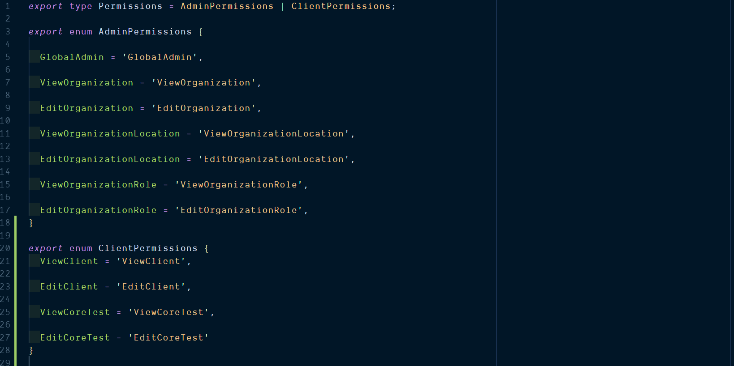

Slide 31
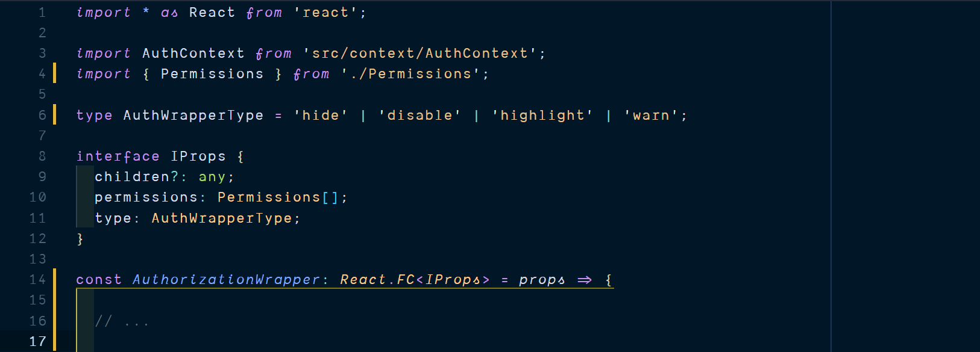

Slide 36
Notes:
Also add gif for deducing type based on usage

Slide 38
Oft quoted TS criticisms
Learning curve
Conflicts with existing libraries
Just another fad
It’s basically JS types with a few new concepts
Thanks to DefinitelyTyped
Nopes
Notes:
3. With the upcoming wasm, it prepares JS for the future, actually. May well be the best thing to happen to JS.
4. Type system is not sound.
5. Babel now transpiles TS to JS

Slide 39
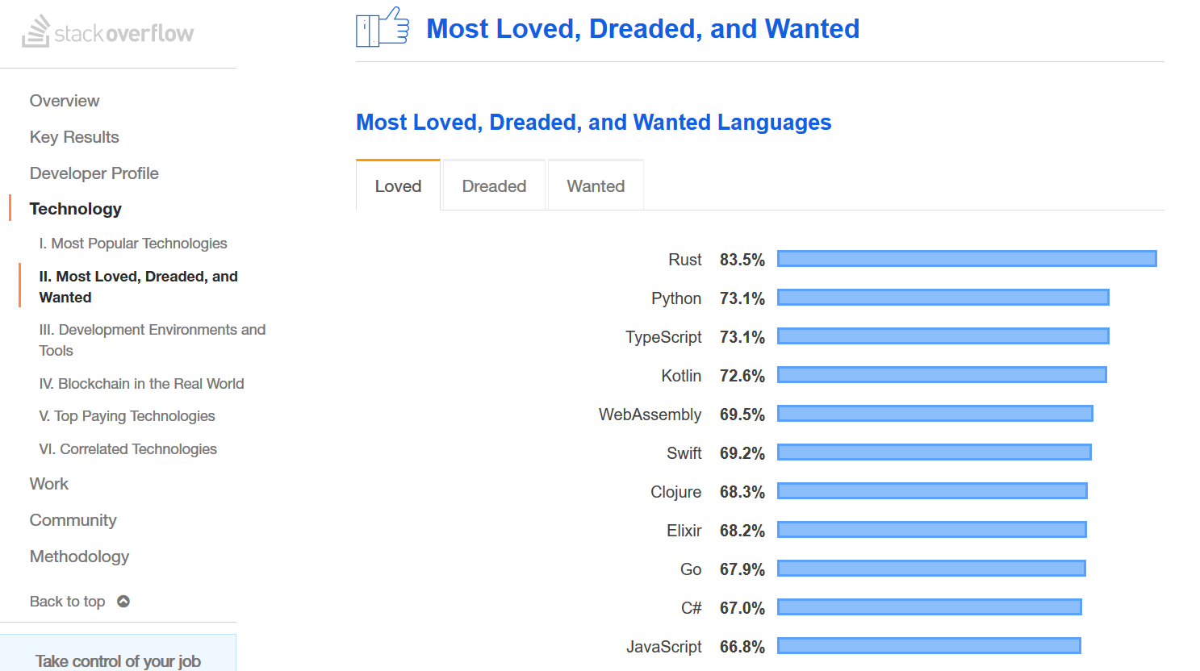

Slide 40
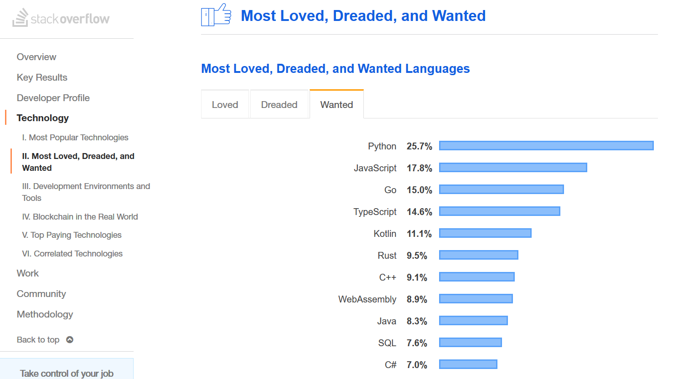

Slide 41
Oft quoted TS criticisms
Learning curve
Conflicts with existing libraries
Just another fad
Does not eliminate 100% run-time errors.
Complicated Error messages.
Difficult initial setup.
Other tools available (like JSDoc, Flow)
It’s basically JS types with a few new concepts
Thanks to DefinitelyTyped
Nopes
Notes:
3. With the upcoming wasm, it prepares JS for the future, actually. May well be the best thing to happen to JS.
4. Type system is not sound.
5. Bebel now transpiles TS to JS
Add other tools, JSDoc, Flow,
Add: does not obviate the need for Testing, Code Reviews etc.

Slide 42


Conclusion
What TS gives us:
Static code analysis
Self documenting code
Union Types & Generic Types
Easy to read and reason code
Easy to maintain and refactor code
What TS does not give us
Immutable values & Data Structures
Pure functions with contained side effects
Minimal shared mutable state
Sound Type system
Zero run-time errors guarantee
Notes:
Should we rename exchangeJS to exchangeTS? Should we just ditch JS altogether? TS to me is more like an extension to JS, a DLC, rather than a stand-alone game

Slide 43
Thank you!

